Slide 1
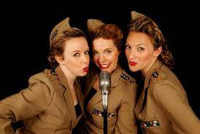
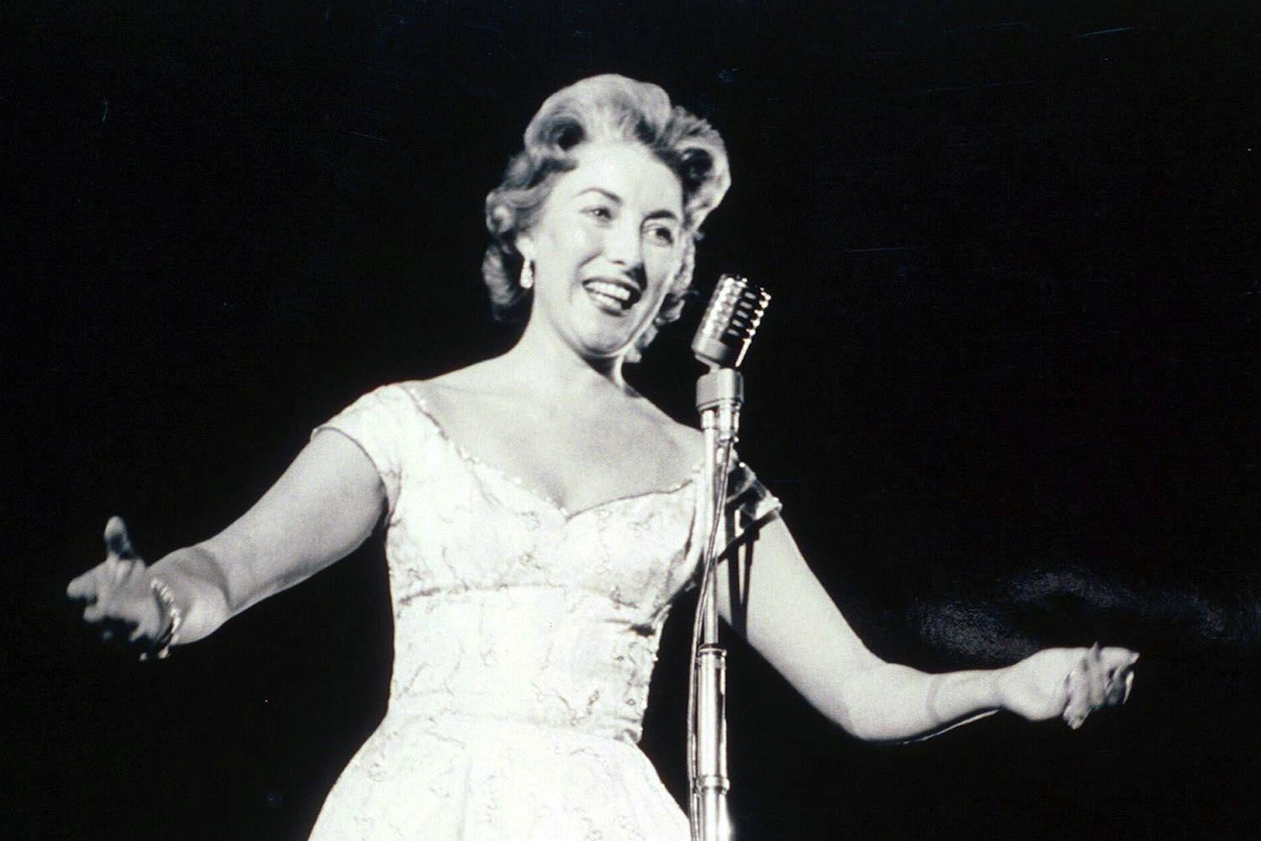
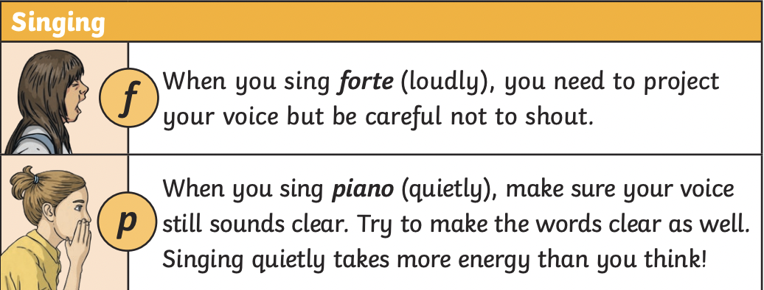
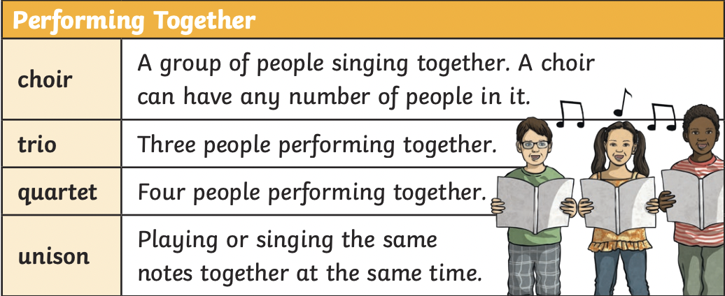
Singing and Percussion
Vera Lynn
Renaissance
1400 - 1600
Elements of Music
Pitch – How high or low a note sounds
Duration – How long or short a note is
Dynamics – How loud or quiet a piece of music is played
Silence – The gaps, rests and breaks in a piece of music
Structure – Overall plan of a piece of music
Tempo – How fast or slow the music is
Timbre – Sound quality of an instrument or voice
Texture – The effect of melodies and harmonies together.
Baroque
1600 - 1750
Classical
1750 - 1827
Romantic
1820 -1900
Modern
1890 - 1960
Contemporary
1960 - Present
Notes:
Learning an Instrument – Glockenspiel
Improvisation

