Slide 1
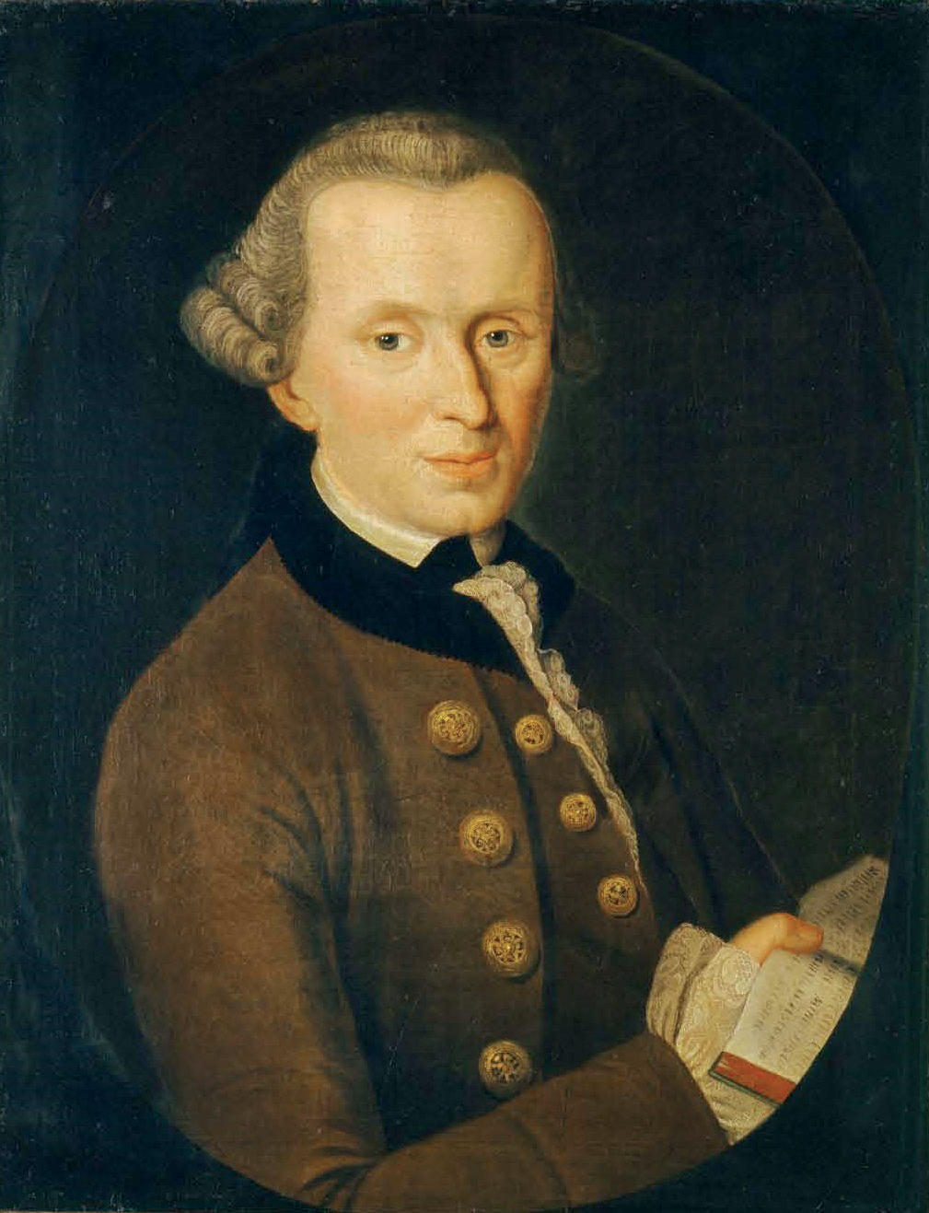
3.3 What is Philosophy?
How do people make moral decisions?
KNOWLEDGE ORGANISER
Key Questions to ask yourself
What helps you to know what is right and wrong? Is doing the right thing always easy? Does knowing rules mean that we automatically follow them?
Key Vocabulary
Word | Definition
Philosophy | Philosophy is the study of some of the most basic questions about human life.
Humanism | Humanisms is the belief that people have one life to live - there is no afterlife. Humanists do not believe in a god. As a result they focus on being happy and making the most of their life. They also believe they have a duty to support others.
Belief | Belief is a firm thought that something is true, with or without evidence.
Rules | A guideline for how people should behave, in terms of right and wrong.
Wisdom | Wisdom is understanding and judging knowledge in order to help a person to live a good life and make good decisions.
Utilitarianism | A philosophy in which decisions are made in order to make the greatest good for the greatest number of people.
Hedonism | A belief that happiness and pleasure are the good things about life.
Morality | The idea of doing the right thing. Morals are basic guidelines for living in terms of right and wrong.
Knowledge is knowing that a tomato is a fruit. Wisdom is not putting it in a fruit salad!
Emmanuel Kant
Kant distinguished 3 categories of knowledge: fact, opinions and beliefs. Facts are certain and can be shown using evidence. Opinions might have reasons behind them but cannot be proven. Belief is more than an opinion, it is considered by the believer to be true.
Facts, opinions and beliefs
Facts | Opinions | Beliefs
Football is a sport | West Ham is the best football team | Ghosts are real
A poodle is a type of dog | Golden retrievers are better than terriers | Stealing is always wrong
Bats are nocturnal animals | Dogs are the most loyal pets. | It is cruel to keep animals in zoos
People are entitled to different beliefs and opinions – we don’t all think the same way It is ok to change your belief or opinion once you have more knowledge & wisdom
The Golden Rule
When speaking of the Golden Rule, Christianity states you should treat others how you want to be treated.

